Slide 1
Introduction to Computer Graphics with WebGL
Camera View Projection
Angel and Shreiner: Interactive Computer Graphics 7E © Addison-Wesley 2015

Slide 2
Computer Viewing
There are three aspects of the viewing process, all of which are implemented in the pipeline,
  Positioning the camera
    Setting the model-view matrix
  Selecting a lens
    Setting the projection matrix
  Clipping
    Setting the view volume
Angel and Shreiner: Interactive Computer Graphics 7E © Addison-Wesley 2015

Slide 3
The WebGL Camera
In WebGL, initially the object and camera frames are the same
  Default model-view matrix is an identity
The camera is located at origin and points in the negative z direction
WebGL also specifies a default view volume that is a cube with sides of length 2 centered at the origin
  Default projection matrix is an identity
Angel and Shreiner: Interactive Computer Graphics 7E © Addison-Wesley 2015

Slide 4
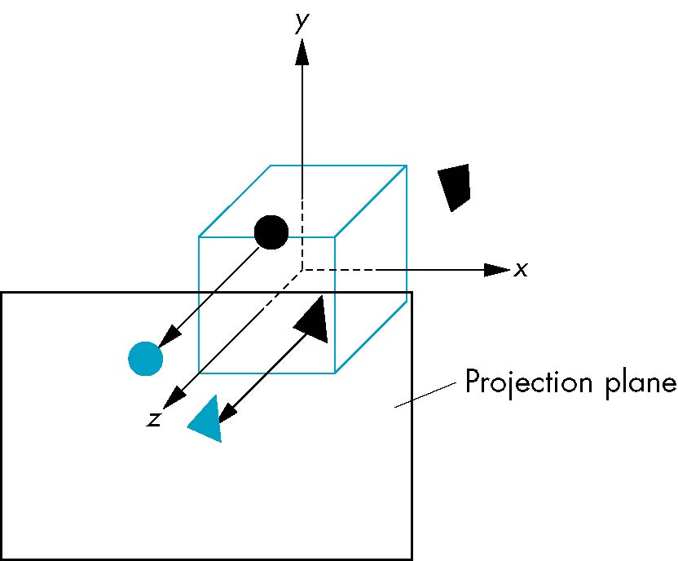
Default Projection
Default projection is orthogonal
clipped out
2
z=0
Angel and Shreiner: Interactive Computer Graphics 7E © Addison-Wesley 2015

Slide 5
Moving the Camera Frame
If we want to visualize objects with both positive and negative z values we can either
  Move the camera in the positive z direction
    Translate the camera frame
  Move the objects in the negative z direction
    Translate the world frame
Both of these views are equivalent and are determined by the model-view matrix
  Want a translation (translate(0.0,0.0,-d);)
  d > 0
Angel and Shreiner: Interactive Computer Graphics 7E © Addison-Wesley 2015

Slide 6
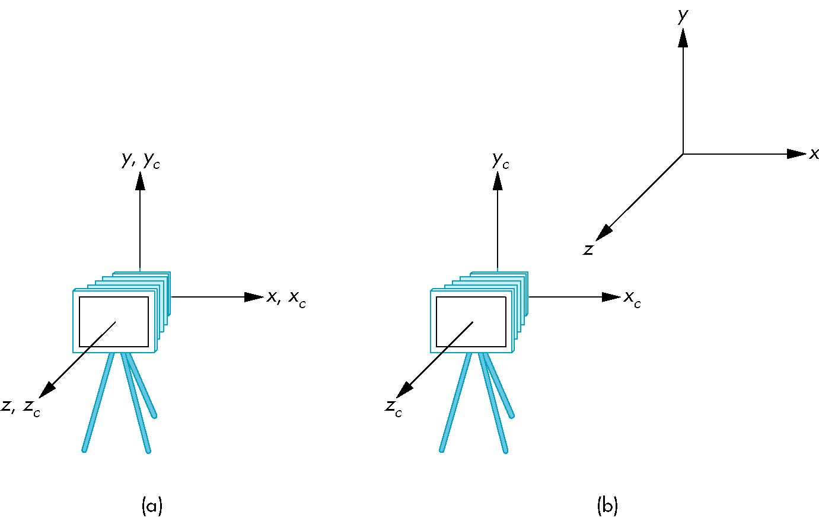
Moving Camera back from Origin
frames after translation by –d
d > 0
default frames
Angel and Shreiner: Interactive Computer Graphics 7E © Addison-Wesley 2015

Slide 7
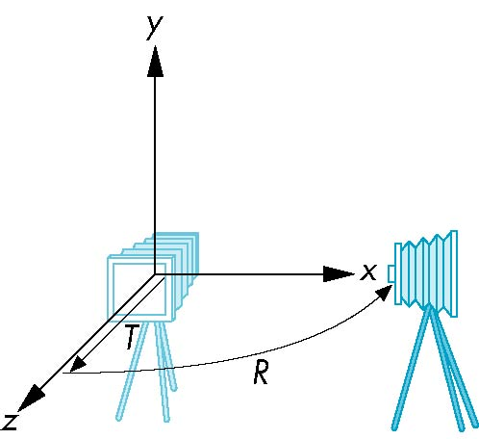
Moving the Camera
We can move the camera to any desired position by a sequence of rotations and translations
Example: side view
  Rotate the camera
  Move it away from origin
  Model-view matrix C = TR
Angel and Shreiner: Interactive Computer Graphics 7E © Addison-Wesley 2015

Slide 8
WebGL code
Remember that last transformation specified is first to be applied
// Using MV.js
var t = translate (0.0, 0.0, -d);
var ry = rotateY(90.0);
var m = mult(t, ry);
or
var m = mult(translate (0.0, 0.0, -d),
rotateY(90.0););
Angel and Shreiner: Interactive Computer Graphics 7E © Addison-Wesley 2015

Slide 9
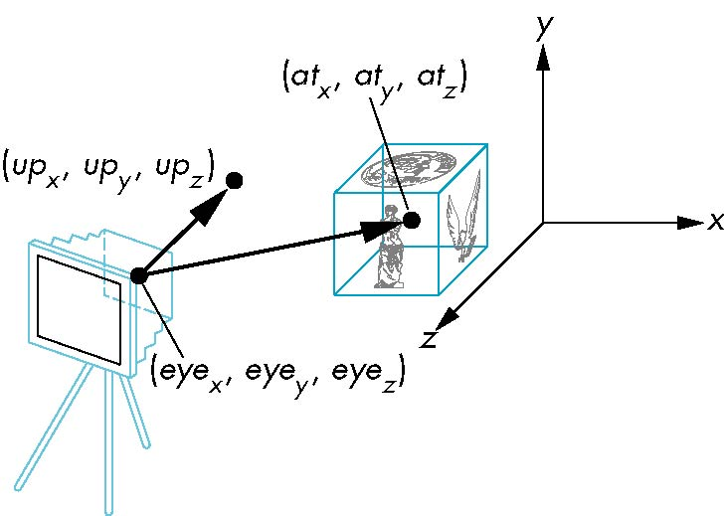
lookAt
LookAt(eye, at, up)
Angel and Shreiner: Interactive Computer Graphics 7E © Addison-Wesley 2015

Slide 10
The lookAt Function
The GLU library contained the function gluLookAt to form the required modelview matrix through a simple interface
Note the need for setting an up direction
Replaced by lookAt() in MV.js
  Can concatenate with modeling transformations
Example: isometric view of cube aligned with axes
var eye = vec3(1.0, 1.0, 1.0);
var at = vec3(0.0, 0.0, 0.0);
var up = vec3(0.0, 1.0, 0.0);
var mv = LookAt(eye, at, up);
Angel and Shreiner: Interactive Computer Graphics 7E © Addison-Wesley 2015

